Slide 1
Week 3 – Sprint Velocity, Milestone Planning, Sprint Goals, and Epics
Michael Dempewolf
November 3, 2016

Slide 2

Agenda
Review
Sprint Velocity
Milestone Planning
Epics
Sprint Goals

Slide 3

Review
What is story estimation?
How do we do it?
What is sprint planning?
What is capacity?
How do you calculate it
What is a burn down chart?
What is it used for?
What is a Story board?

Slide 4
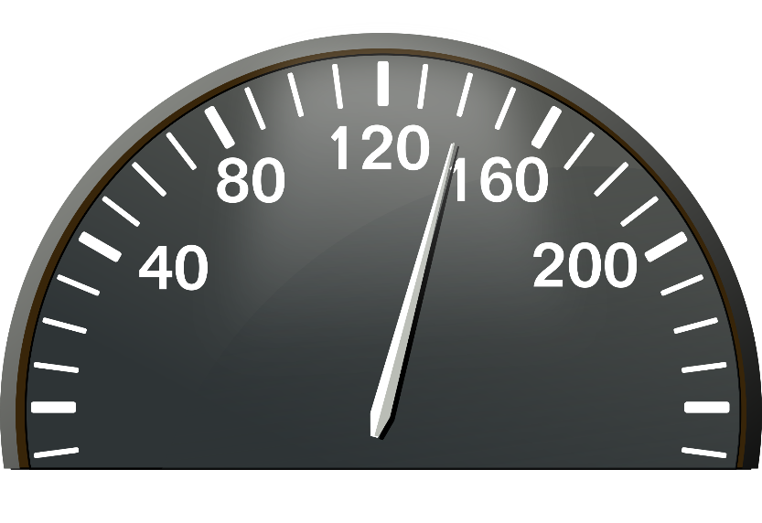
Sprint velocity
Sprint velocity (as defined by Scrum Alliance) is the rate at which teams deliver stories from the product backlog
Sprint velocity is similar to velocity when driving a car! What does 55 miles per hour really tell you?
Used for:
Knowing how much value have delivered until now
Predicting when you will be able to complete all (or a subset) of stories from the backlog
Predicting how many user stories you will have complete by a certain date.

Slide 5
Sprint velocity (example)
Sprint velocity equals the average of our last three sprints
If we completed 20, 24, and 19 story points in our last three sprints then our velocity is (20 + 24 + 19)/3 or 63/3 which is 21.
We can use this to predict we will complete 105 story points in the next 5 sprints. 5 x 21 = 105 story points.
Why do we use only the last 3 sprints?
What if we are on our 1st or 2nd sprint?

Slide 6
Milestone Planning
We use sprint velocity to plan our milestone.
Product Backlog contains user stories with story points assigned to them, sorted by priority.
We can use this information to predict:
What we can complete given X number of sprints (or by a certain date)
How many sprints (and date) for completing a specific set of user stories
Cut off line - A line in the Product Backlog which illustrates what has to completed by the end of the milestone and what does not need to be completed.

Slide 7
Milestone Planning (Example)
Sprint Velocity = 15
User story | Story Points
As a user, I would like to be able to do … | 13
As a user, I would like to view … | 8
As a user, I would like to receive … | 5
As a worker, I would like to be able to do … | 13
As a worker, I would like to view … | 8
As a worker, I would like to receive … | 5
As a supervisor, I would to be able to do … | 13
As a supervisor, I would like to view … | 8
As a supervisor, I would like to receive … | 5
As a visitor, I would like to be able to …. | 13
How many sprints will it take to complete all required stories (above cut offline)?
Sprint 1
6!
78 / 15
Sprint 2
Sprint 3
Sprint 4
Sprint 5
Sprint 6

Slide 8
Milestone Planning (Example)
Sprint Velocity = 15
User story | Story Points
As a user, I would like to be able to do … | 13
As a user, I would like to view … | 8
As a user, I would like to receive … | 5
As a worker, I would like to be able to do … | 13
As a worker, I would like to view … | 8
As a worker, I would like to receive … | 5
As a supervisor, I would to be able to do … | 13
As a supervisor, I would like to view … | 8
As a supervisor, I would like to receive … | 5
As a visitor, I would like to be able to …. | 13
Where is cut off line if we only have 4 sprints until release?
Sprint 1
Sprint 2
4 X 15 = 60
We will complete 52 by this point
Sprint 3
Sprint 4

Slide 9

Release Burndown
Similar to Sprint burn down chart
Uses sprints and story points completed
Useful for monitoring the progress of a release/milestone
Scrum Master is responsible for managing
Product Owner monitors the release burndown closely

Slide 10
Release burn down example

Slide 11
Epics
EPIC!
What if a story is so large it can be assigned a story point estimate?
Epics are large stories which are so big they cannot be easily assigned a story point value.
Epics are broken into smaller user stories which make up the epic.
Used to group or categorize user stories.
Example: As a user I want to view all of my requests on a map as symbols representing the department responsible for resolving the issue.

Slide 12


Sprint goals
Each sprint should have a sprint goal. What does the team expect to accomplish by the end of the sprint?
Used a reference point or guide. Is what I am working on helping to accomplish the sprint goal?
Review the user stories for the sprint, what does it mean if we complete them?

Slide 13

Questions

Slide 14
References:
Question mark = http://www.agile-code.com/blog/easy-task-estimation-with-three-point-estimation-technique/

Slide 15
Questions for you
What happens if the Product Owner decides to change the priority of the project backlog in the middle of the sprint and the change brings a lower priority user story to the very top? What if the story is not in the sprint now?
What do you do when a manager or CEO comes down and redirects a development team member who is currently working on a sprint?

